Slide 1
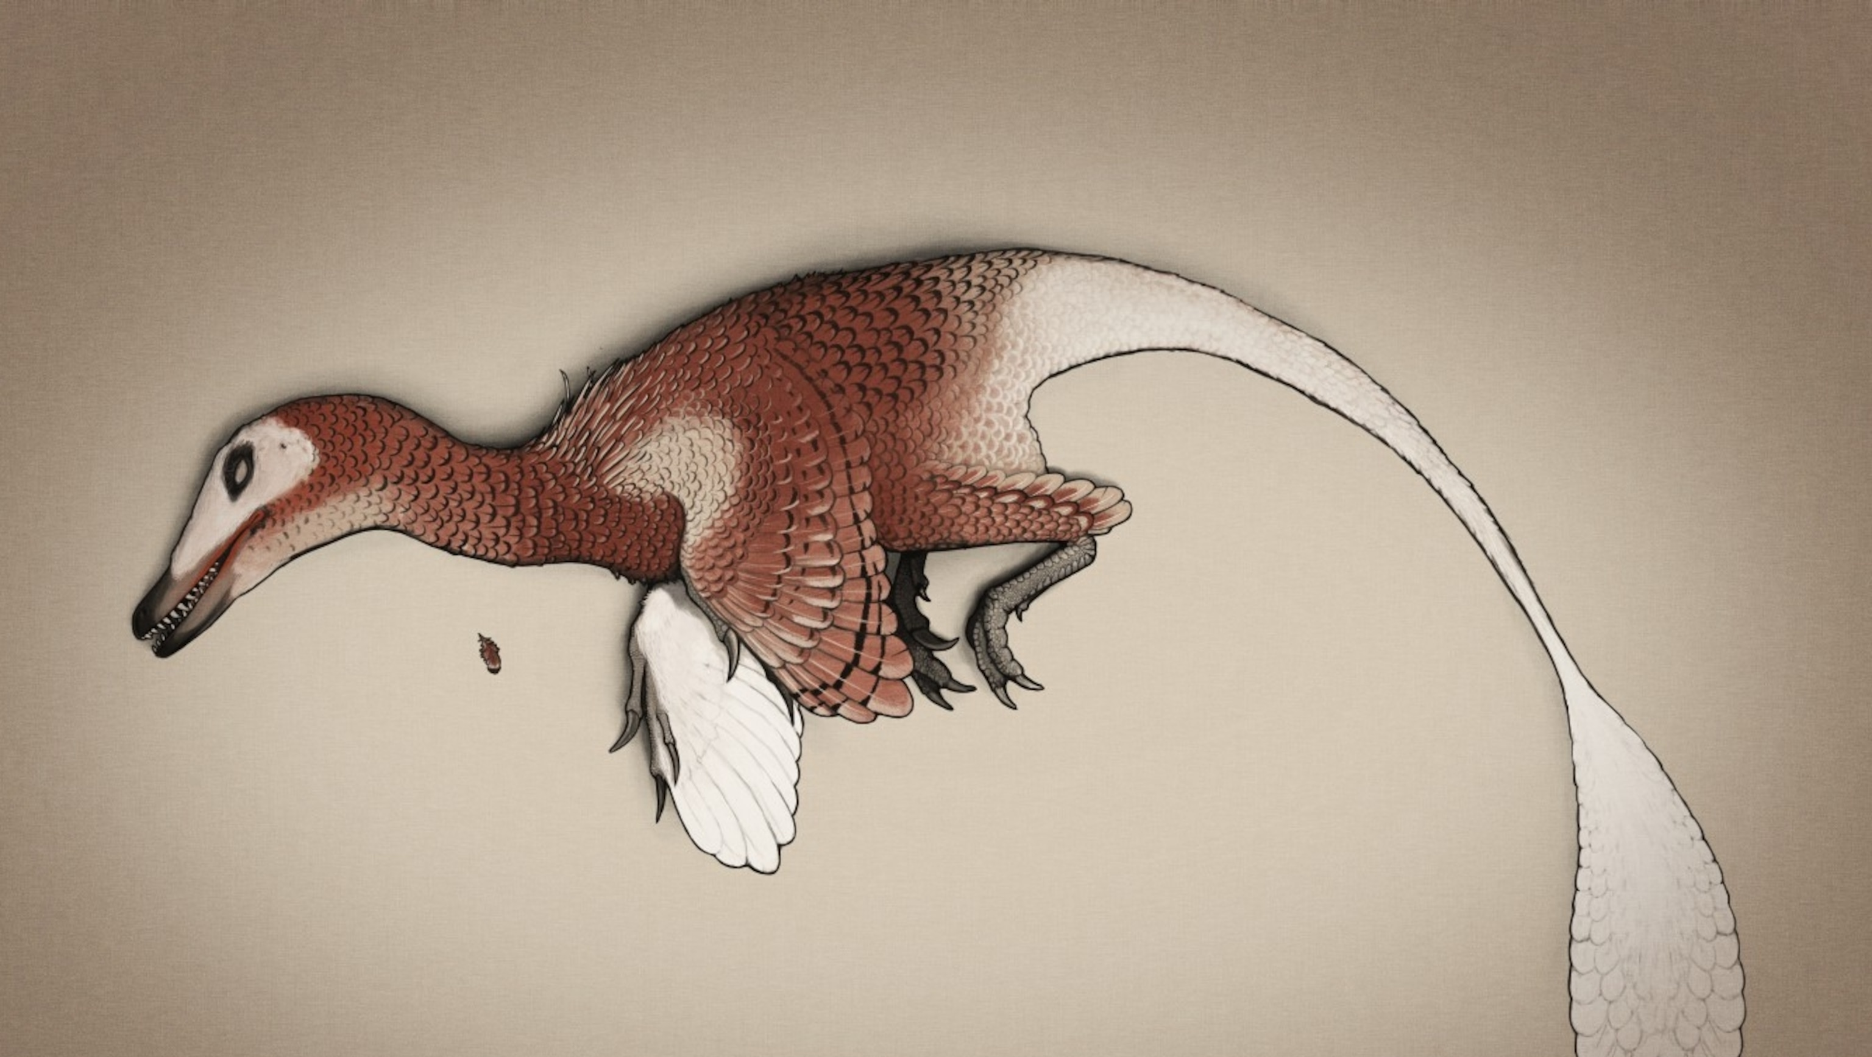
‘Paleo-estimation’:
Body mass in bipedal dinosaurs
Viviana Romero Alarcon
2023 / 12 /07

Slide 2
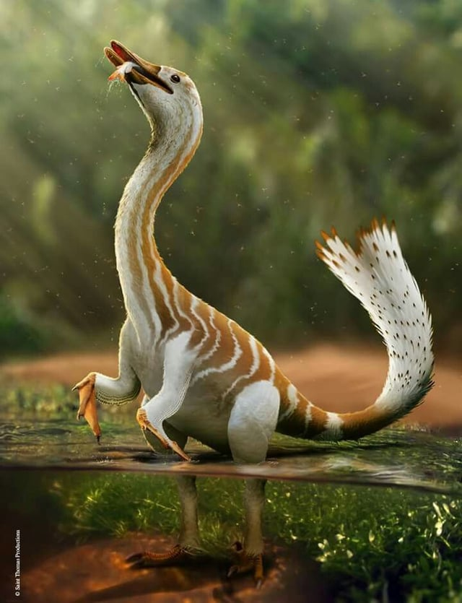
physiology
Body mass
Ecology
phylogeny

Slide 3
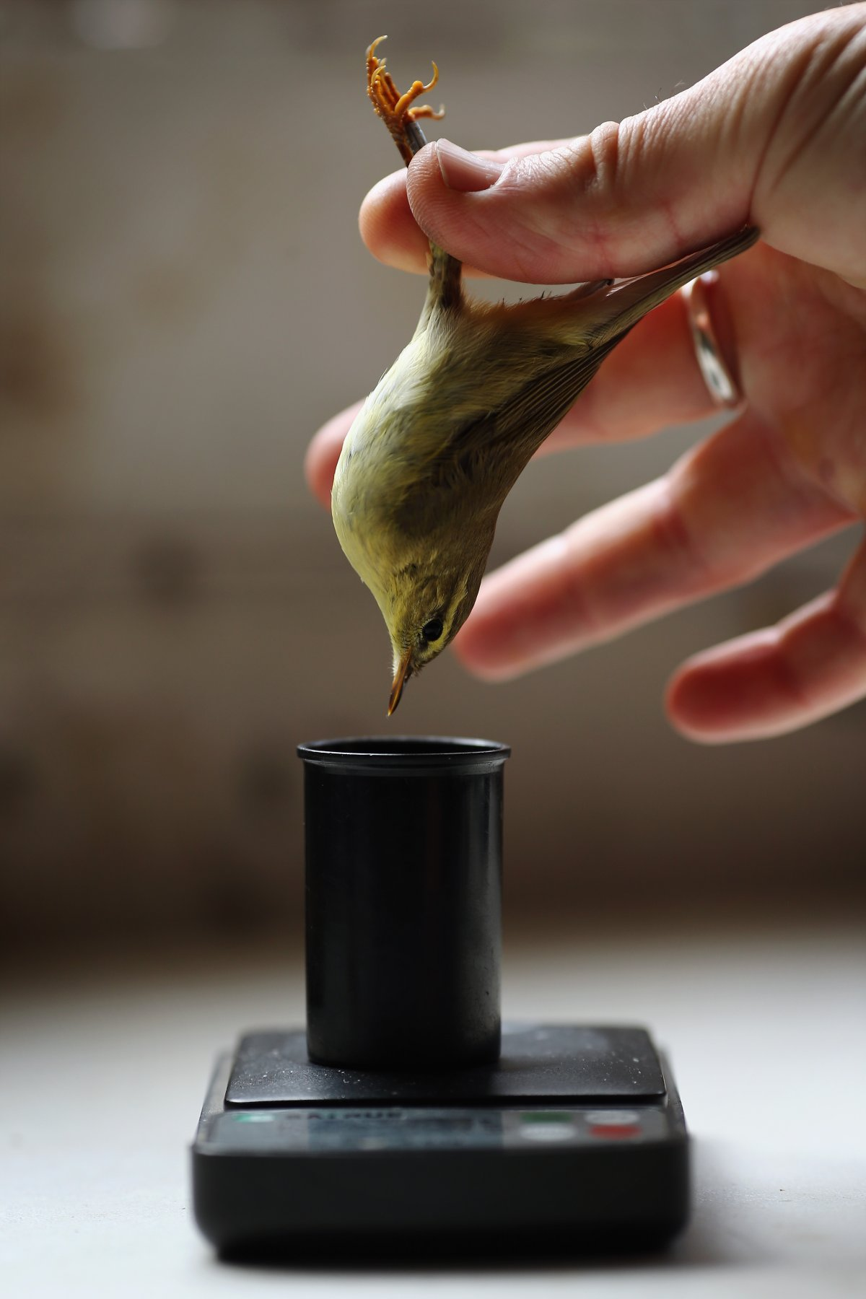
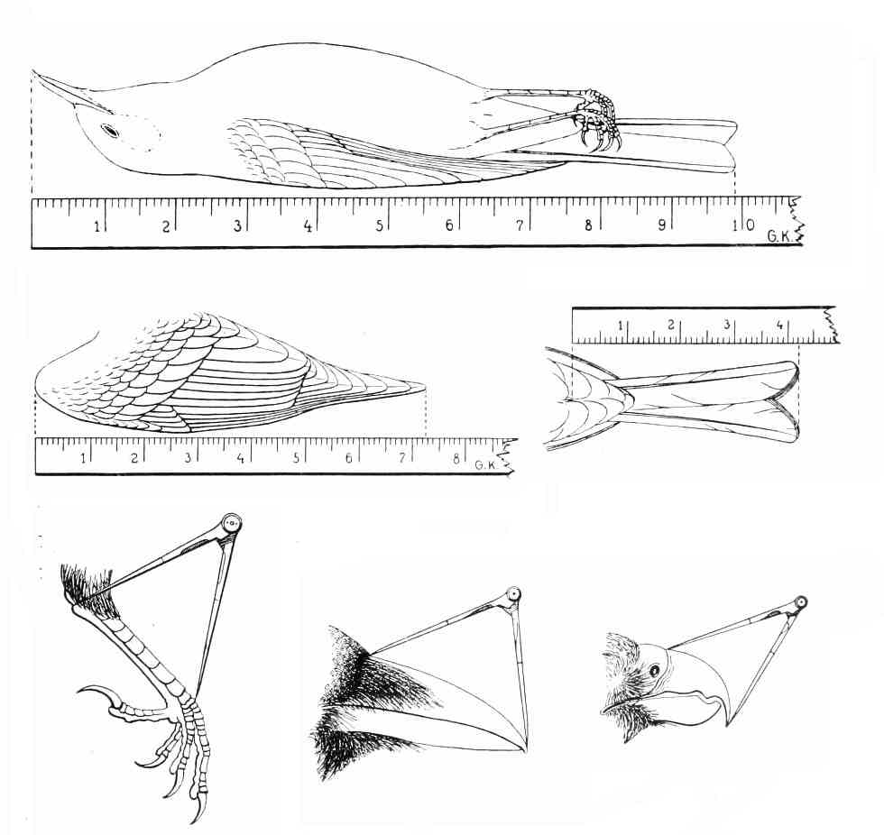
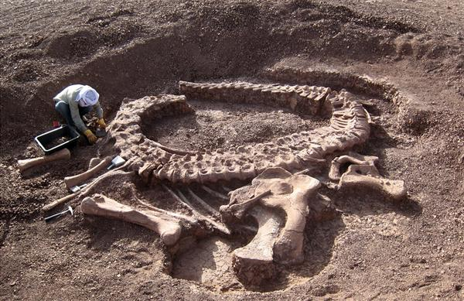
Get body mass extant species => weigh
Get body mass extinct species => Prediction

Slide 4
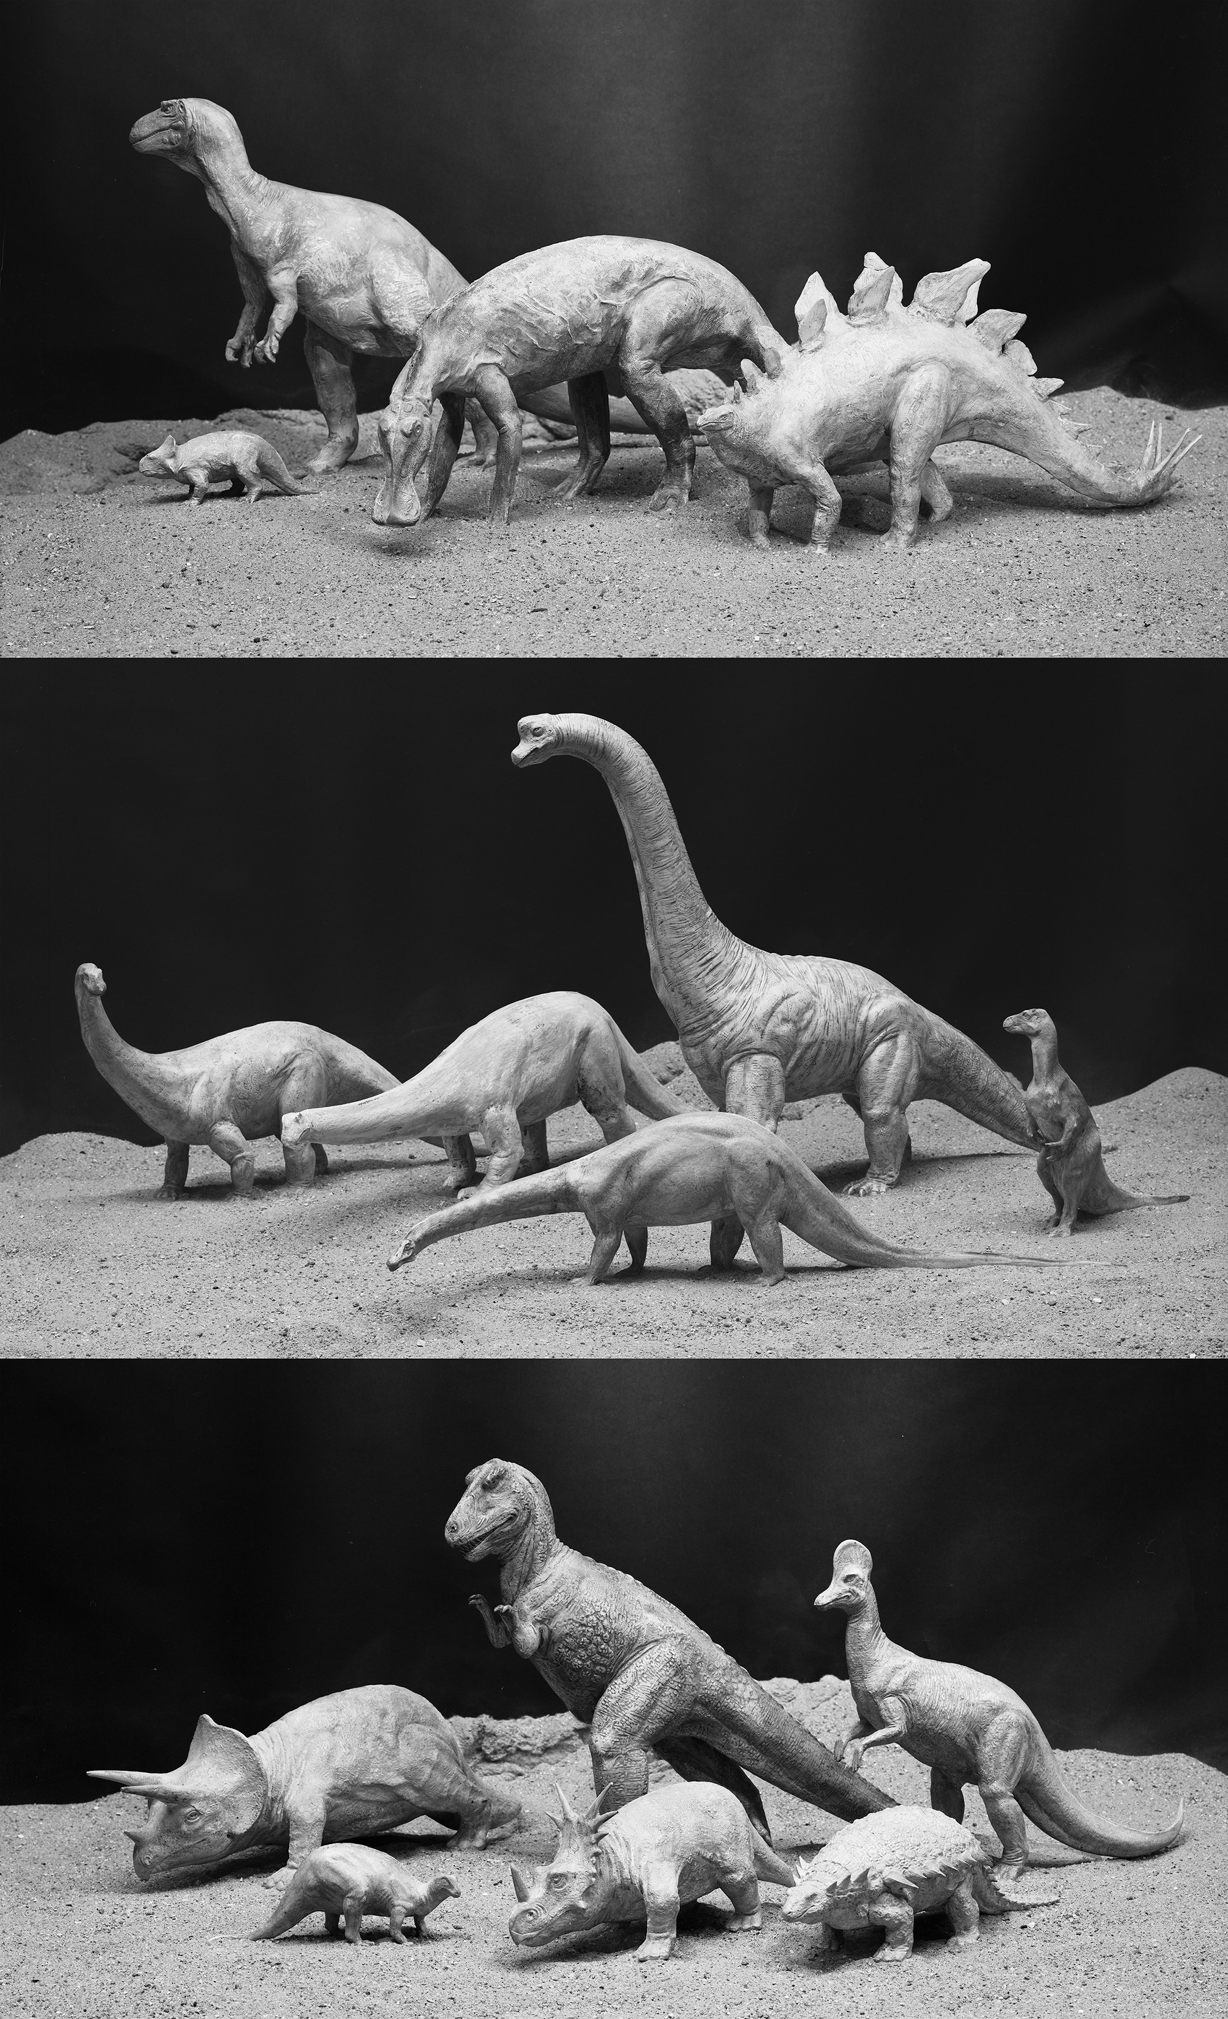
Body mass - paleoEstimation
Volumetric-density (VD)
Extant-scaling (ES)
Physical scale models
Two-dimentional mathematical model
Three-dimentional virtual model
BM ~ 0.16 C_{femur} ^{2.73}
(Anderson et al 1985)
BM ~ 2.411 log₁₀ C_{femur} – 0.065
(Cambell Jr & Marcus 1992)
BM ~ 2.4 log C_{femur} – 0.11
(Field et al 2013)
BM ~ 2.754 log C_{femur} – 0.683
(Campione et al 2014)

Slide 5
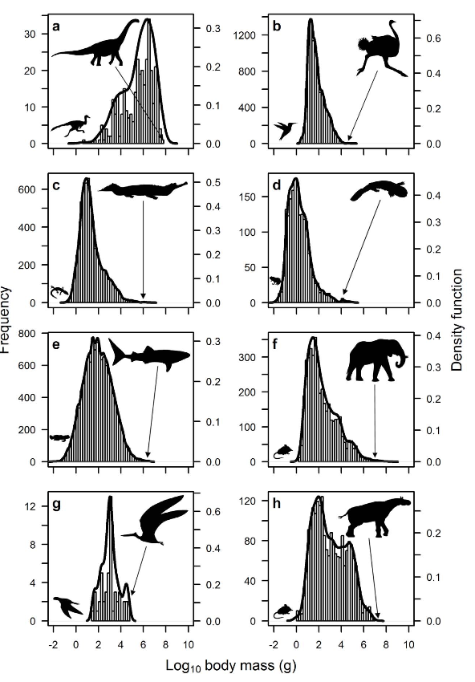
Body mass - paleoEstimation
Extant-scaling (ES)
Pros:
Generate large data sets to reconstruct large-scale patterns of evolution
Allow to study physiological and ecological on a macroevolutionary scale
Cheap and easy to use
Cons:
Overestimation in theropods
No way to measure the actual weight
BM ~ 0.16 C_{femur} ^{2.73}
(Anderson et al 1985)
BM ~ 2.411 log₁₀ C_{femur} – 0.065
(Cambell Jr & Marcus 1992)
BM ~ 2.4 log C_{femur} – 0.11
(Field et al 2013)
BM ~ 2.754 log C_{femur} – 0.683
(Campione et al 2014)
(O`Gornan & Hone 2012)

Slide 6
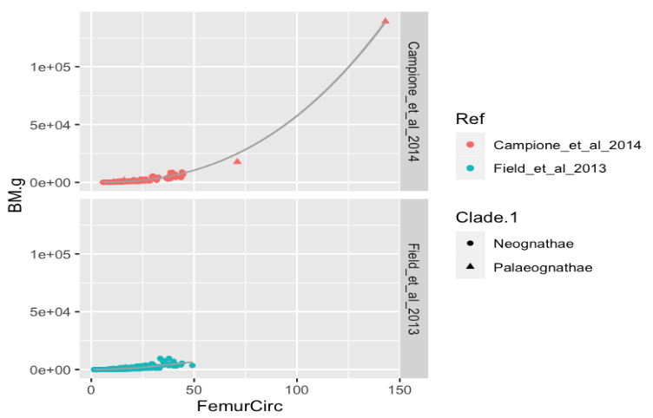
Body mass - paleoEstimation
Extant-scaling (ES)
BM ~ 0.16 C_{femur} ^{2.73}
(Anderson et al 1985)
BM ~ 2.411 log₁₀ C_{femur} – 0.065
(Cambell Jr & Marcus 1992)
BM ~ 2.4 log C_{femur} – 0.11
(Field et al 2013)
BM ~ 2.754 log C_{femur} – 0.683
(Campione et al 2014)

Slide 7
Body mass - paleoEstimation
Extant-scaling (ES)
BM ~ 0.16 C_{femur} ^{2.73}
(Anderson et al 1985)
BM ~ 2.411 log₁₀ C_{femur} – 0.065
(Cambell Jr & Marcus 1992)
BM ~ 2.4 log C_{femur} – 0.11
(Field et al 2013)
BM ~ 2.754 log C_{femur} – 0.683
(Campione et al 2014)
No samples from the biggest modern birds

Slide 8
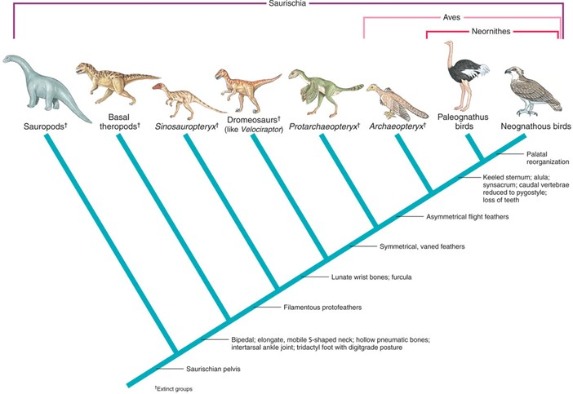
Palaeognathae group:
Heaviest modern birds (extant species)
Flightless birds ~ Theropods

Slide 9
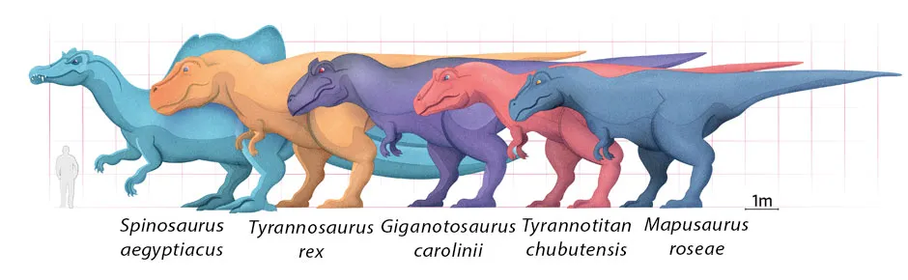
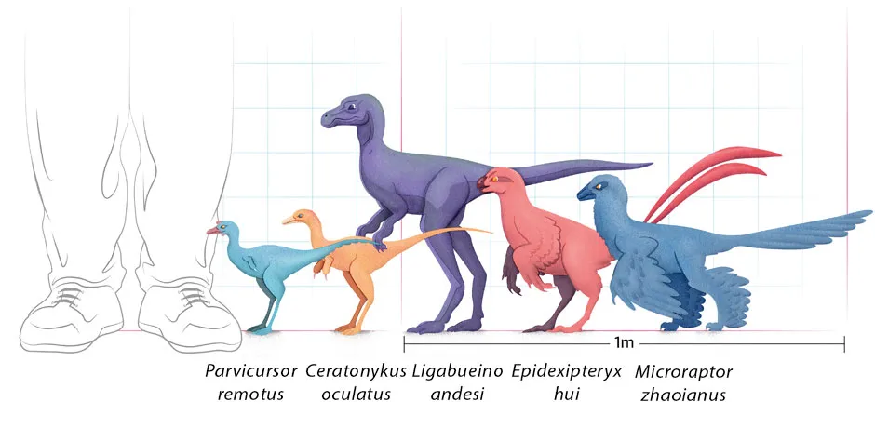
Could I improve the model,
if I included samples from
the Palaeognathae group?
(Bright, 2021 in BBC)

Slide 10
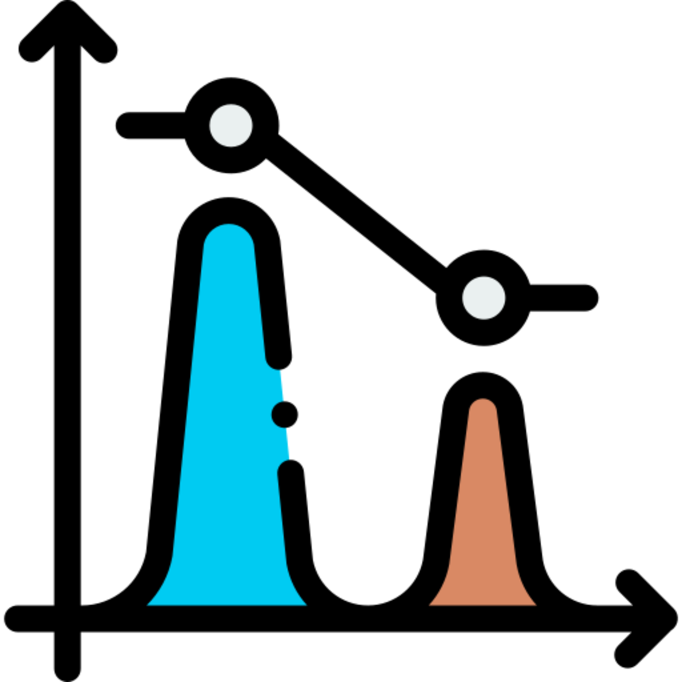
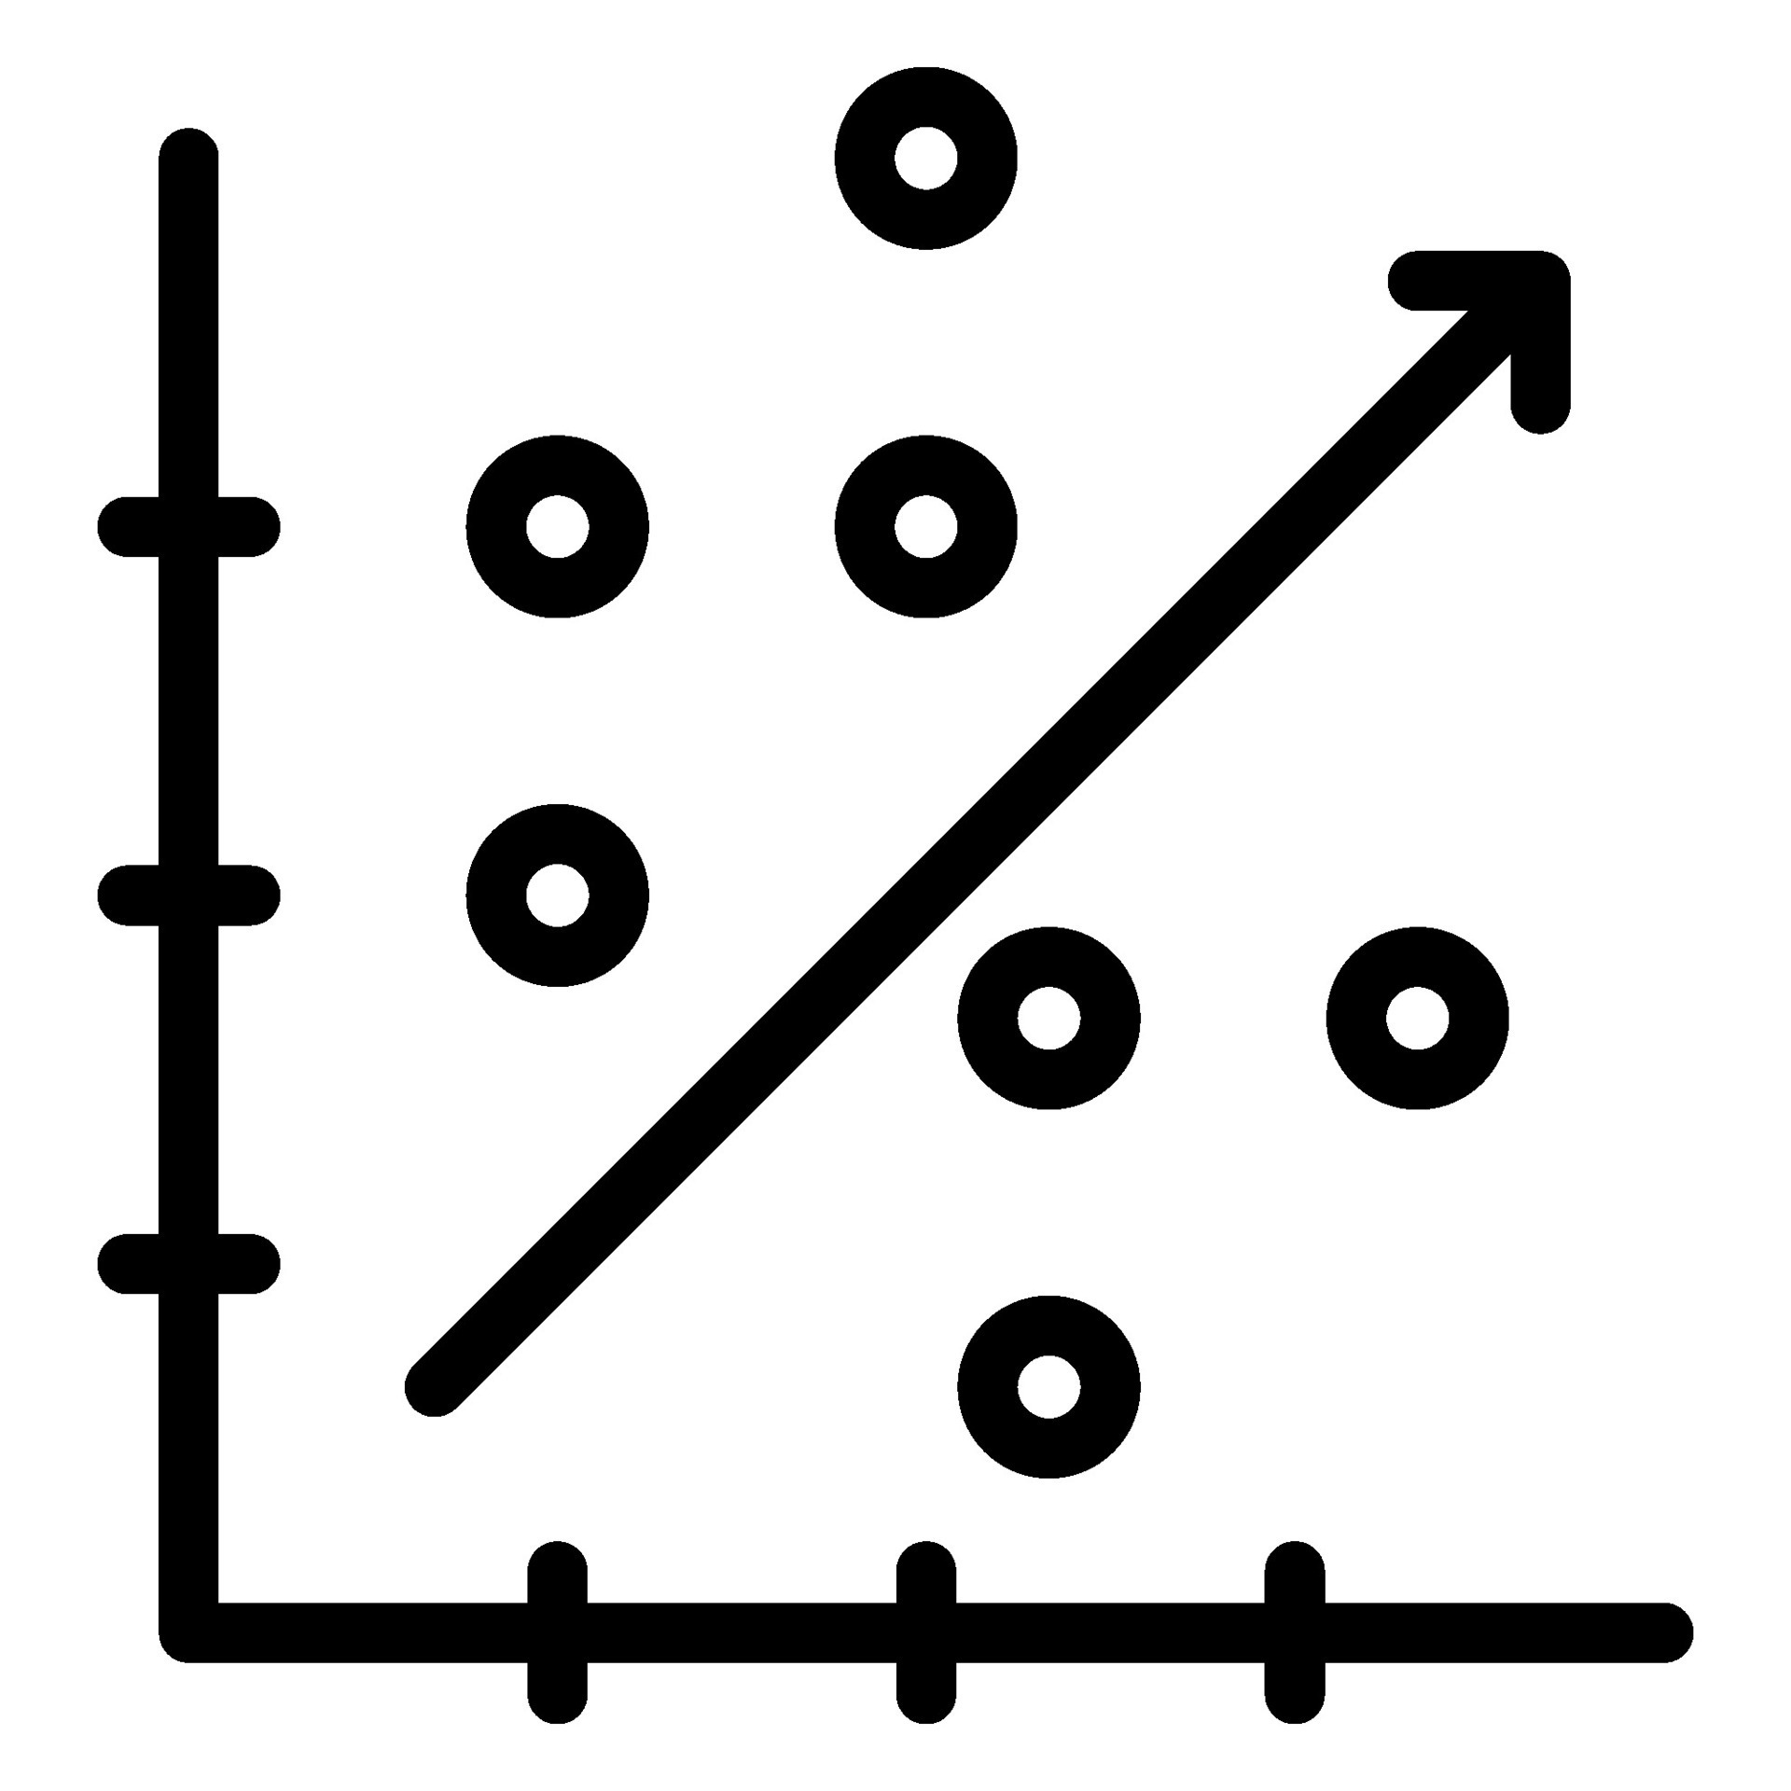
Body mass - paleoEstimation
Train: 80%
Test: 20%
Campione&Benson 2020
Chan 2017
Field et al 2013
Campione et al 2014
Distributions
BM.g ~ FC
log(BM.g) ~ log(FC)
BM.g ~ poly(FC, 2)
BM.g ~ poly(FC, 3)
BM.g ~ spline(FC, knot = 25)
BM.g ~ spline(FC, 25, 50)
MSE
Seed:999
Relationship
Best Model
Kfold (10) - Cross Valid.
MAE
Dataset
# sp: 446
# Orders: 27
# Obs: 1036
Femur Circumference ~ Femur Length
Prediction
Distributions
Relationship
Dataset
# sp: 552
# Orders: 32
# Obs: 1172
71 Observations
Theropods
Palaeognathae
Dataset
Distributions
Relationship
Dataset
# sp: 35
# Orders: 9
# Obs: 111
# sp: 15
# Orders: 5
# Obs: 20
FC ~ FL
FC ~ FL + Clade.1
FC ~ FL + Clade.2
log(FC) ~ log(FL)
log(FC) ~ log(FL) + Clade.1
log(FC) ~ log(FL) + Clade.2
FC ~ poly(FL,2)
FC ~ poly(FL,2) +Clade.1
FC ~ poly(FL,2) + Clade.2
Canoville et al 2022
Chadwick et al 2014
Crouch&Clarke 2019
Elzanowski&Louchart 2022
Gatesy&Middleton 1997
BM ~ 0.16 C_{femur} ^{2.73}
(Anderson et al 1985)
log10(BM) ~ 2.411 log₁₀ C_{femur} – 0.065
(Cambell Jr & Marcus 1992)
log(BM) ~ 2.4 log C_{femur} – 0.11
(Field et al 2013)
log(BM) ~ 2.754 log10 C_{femur} – 0.683
(Campione et al 2014)
log(BM) ~ 2.37699 log C_{femur} – 0.09121
(This analysis)
Back transform
$\sum{PPE}=\frac{\frac{\sum{Obs−pred}}{pred}∗100}{n}$
Train: 80%
Test: 20%
Whole dataset
Palaeognathae
Log
MSE
AIC
Prediction

Slide 11
Body mass - paleoEstimation
Train: 80%
Test: 20%
Campione&Benson 2020
Chan 2017
Field et al 2013
Campione et al 2014
Distributions
BM.g ~ FC
log(BM.g) ~ log(FC)
BM.g ~ poly(FC, 2)
BM.g ~ poly(FC, 3)
BM.g ~ spline(FC, knot = 25)
BM.g ~ spline(FC, 25, 50)
MSE
Seed:999
Relationship
Best Model
Kfold (10) - Cross Valid.
MAE
Dataset
# sp: 446
# Orders: 27
# Obs: 1036
Femur Circumference ~ Femur Length
Prediction
Distributions
Relationship
Dataset
# sp: 552
# Orders: 32
# Obs: 1172
71 Observations
Theropods
Palaeognathae
Dataset
Distributions
Relationship
Dataset
# sp: 35
# Orders: 9
# Obs: 111
# sp: 15
# Orders: 5
# Obs: 20
FC ~ FL
FC ~ FL + Clade.1
FC ~ FL + Clade.2
log(FC) ~ log(FL)
log(FC) ~ log(FL) + Clade.1
log(FC) ~ log(FL) + Clade.2
FC ~ poly(FL,2)
FC ~ poly(FL,2) +Clade.1
FC ~ poly(FL,2) + Clade.2
Canoville et al 2022
Chadwick et al 2014
Crouch&Clarke 2019
Elzanowski&Louchart 2022
Gatesy&Middleton 1997
BM ~ 0.16 C_{femur} ^{2.73}
(Anderson et al 1985)
log10(BM) ~ 2.411 log₁₀ C_{femur} – 0.065
(Cambell Jr & Marcus 1992)
log(BM) ~ 2.4 log C_{femur} – 0.11
(Field et al 2013)
log(BM) ~ 2.754 log10 C_{femur} – 0.683
(Campione et al 2014)
log(BM) ~ 2.37699 log C_{femur} – 0.09121
(This analysis)
Back transform
$\sum{PPE}=\frac{\frac{\sum{Obs−pred}}{pred}∗100}{n}$
Train: 80%
Test: 20%
Whole dataset
Palaeognathae
Log
MSE
AIC
Prediction

Slide 12
Body mass - paleoEstimation
Train: 80%
Test: 20%
Campione&Benson 2020
Chan 2017
Field et al 2013
Campione et al 2014
Distributions
BM.g ~ FC
log(BM.g) ~ log(FC)
BM.g ~ poly(FC, 2)
BM.g ~ poly(FC, 3)
BM.g ~ spline(FC, knot = 25)
BM.g ~ spline(FC, 25, 50)
MSE
Seed:999
Relationship
Best Model
Kfold (10) - Cross Valid.
MAE
Dataset
# sp: 446
# Orders: 27
# Obs: 1036
Femur Circumference ~ Femur Length
Prediction
Distributions
Relationship
Dataset
# sp: 552
# Orders: 32
# Obs: 1172
71 Observations
Theropods
Palaeognathae
Dataset
Distributions
Relationship
Dataset
# sp: 35
# Orders: 9
# Obs: 111
# sp: 15
# Orders: 5
# Obs: 20
FC ~ FL
FC ~ FL + Clade.1
FC ~ FL + Clade.2
log(FC) ~ log(FL)
log(FC) ~ log(FL) + Clade.1
log(FC) ~ log(FL) + Clade.2
FC ~ poly(FL,2)
FC ~ poly(FL,2) +Clade.1
FC ~ poly(FL,2) + Clade.2
Canoville et al 2022
Chadwick et al 2014
Crouch&Clarke 2019
Elzanowski&Louchart 2022
Gatesy&Middleton 1997
BM ~ 0.16 C_{femur} ^{2.73}
(Anderson et al 1985)
log10(BM) ~ 2.411 log₁₀ C_{femur} – 0.065
(Cambell Jr & Marcus 1992)
log(BM) ~ 2.4 log C_{femur} – 0.11
(Field et al 2013)
log(BM) ~ 2.754 log10 C_{femur} – 0.683
(Campione et al 2014)
log(BM) ~ 2.37699 log C_{femur} – 0.09121
(This analysis)
Back transform
$\sum{PPE}=\frac{\frac{\sum{Obs−pred}}{pred}∗100}{n}$
Train: 80%
Test: 20%
Whole dataset
Palaeognathae
Log
MSE
AIC
Prediction

Slide 13
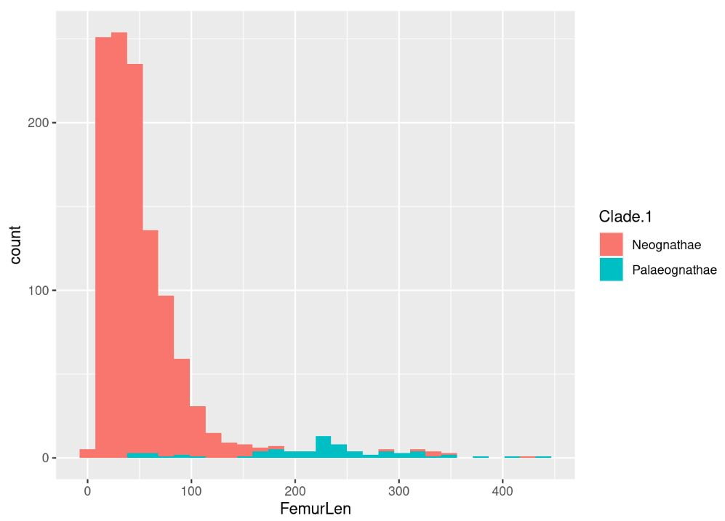
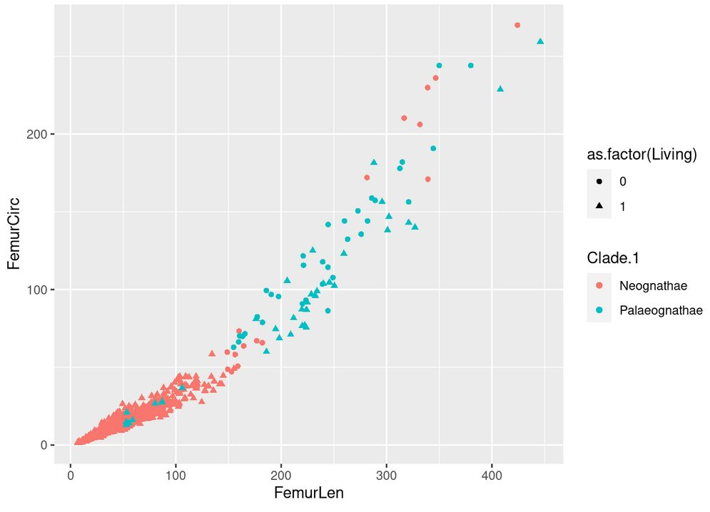
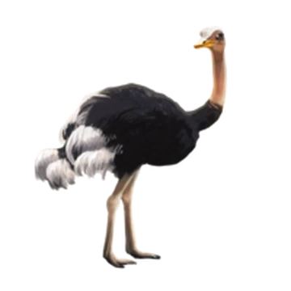
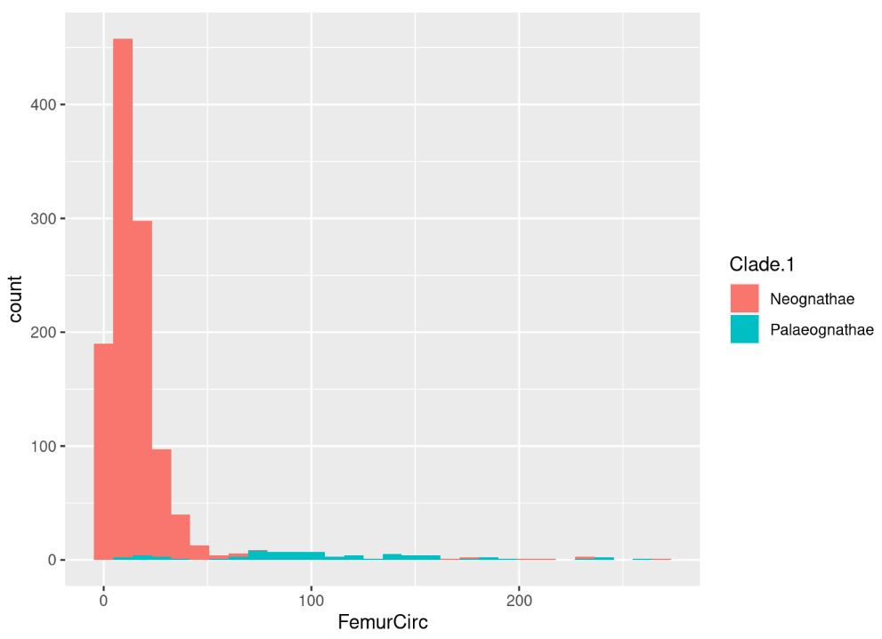
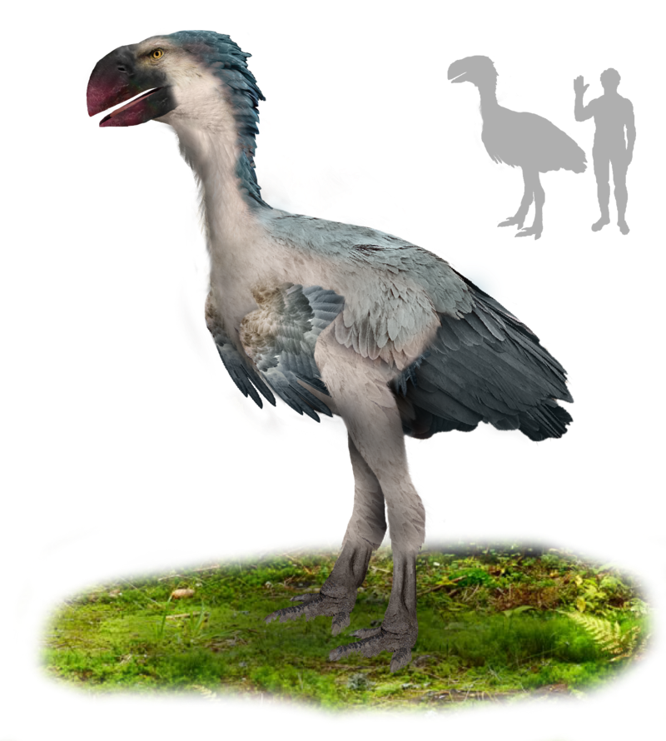
Femur Circumference ~ Femur Length

Slide 14
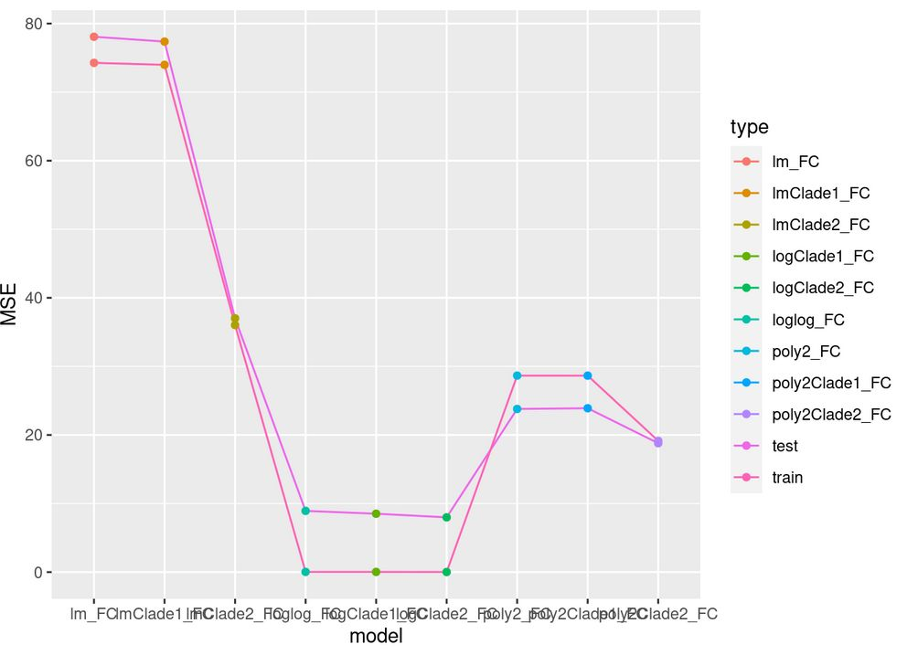
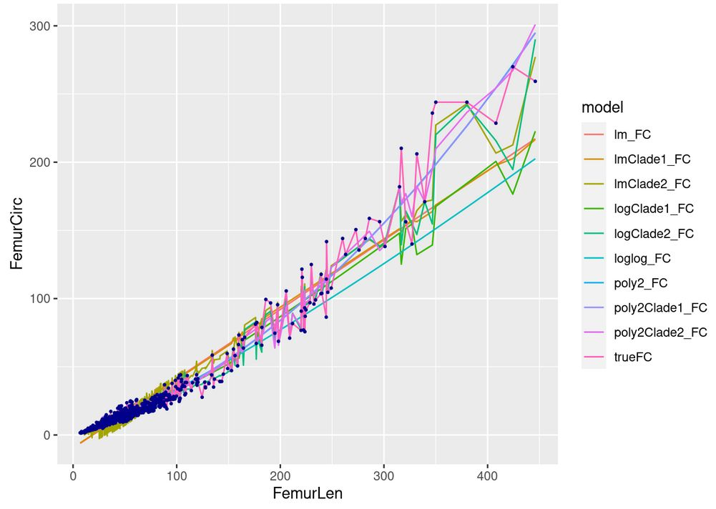
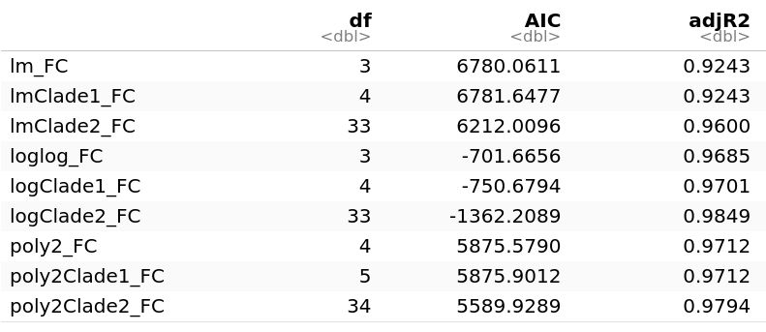
Femur Circumference ~ Femur Length

Slide 15
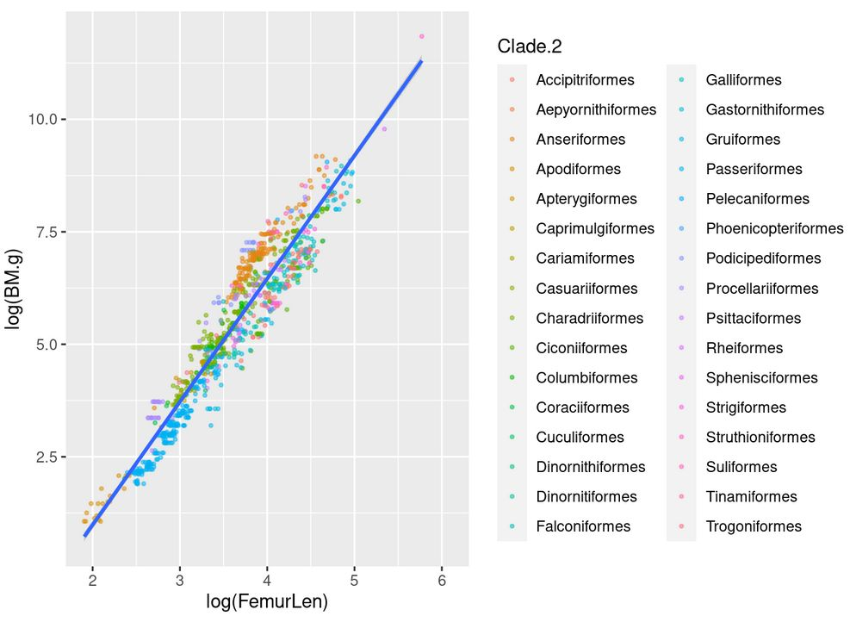
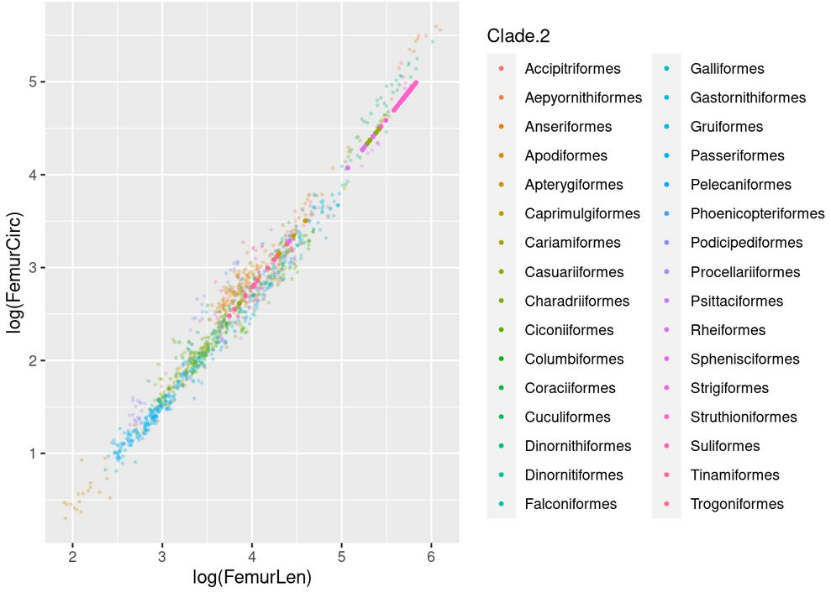
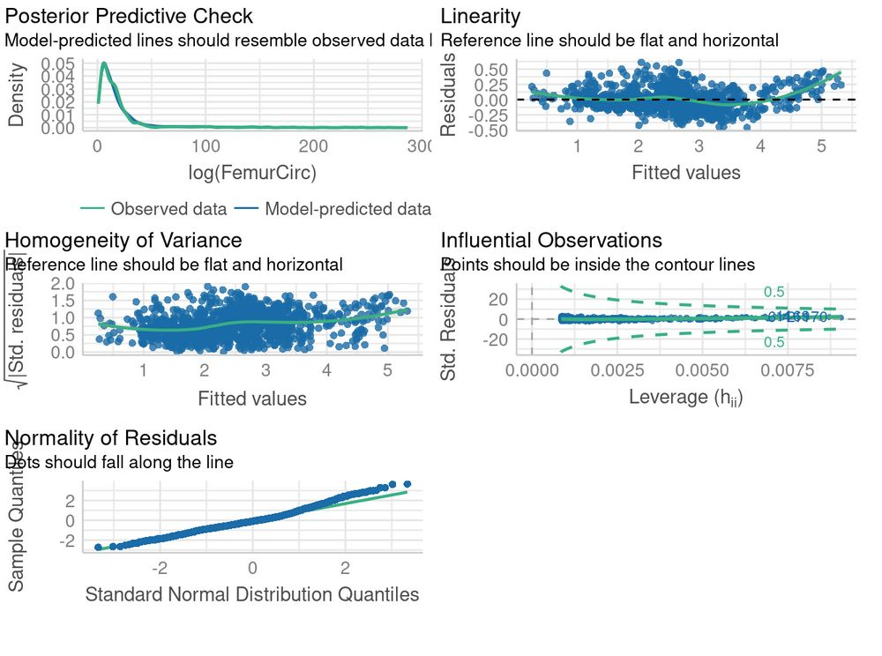
Log(Femur Circumference) ~ log(Femur Length) + Orders

Slide 16
Body mass - paleoEstimation
Train: 80%
Test: 20%
Campione&Benson 2020
Chan 2017
Field et al 2013
Campione et al 2014
Distributions
BM.g ~ FC
log(BM.g) ~ log(FC)
BM.g ~ poly(FC, 2)
BM.g ~ poly(FC, 3)
BM.g ~ spline(FC, knot = 25)
BM.g ~ spline(FC, 25, 50)
MSE
Seed:999
Relationship
Best Model
Kfold (10) - Cross Valid.
MAE
Dataset
# sp: 446
# Orders: 27
# Obs: 1036
Femur Circumference ~ Femur Length
Prediction
Distributions
Relationship
Dataset
# sp: 552
# Orders: 32
# Obs: 1172
71 Observations
Theropods
Palaeognathae
Dataset
Distributions
Relationship
Dataset
# sp: 35
# Orders: 9
# Obs: 111
# sp: 15
# Orders: 5
# Obs: 20
FC ~ FL
FC ~ FL + Clade.1
FC ~ FL + Clade.2
log(FC) ~ log(FL)
log(FC) ~ log(FL) + Clade.1
log(FC) ~ log(FL) + Clade.2
FC ~ poly(FL,2)
FC ~ poly(FL,2) +Clade.1
FC ~ poly(FL,2) + Clade.2
Canoville et al 2022
Chadwick et al 2014
Crouch&Clarke 2019
Elzanowski&Louchart 2022
Gatesy&Middleton 1997
BM ~ 0.16 C_{femur} ^{2.73}
(Anderson et al 1985)
log10(BM) ~ 2.411 log₁₀ C_{femur} – 0.065
(Cambell Jr & Marcus 1992)
log(BM) ~ 2.4 log C_{femur} – 0.11
(Field et al 2013)
log(BM) ~ 2.754 log10 C_{femur} – 0.683
(Campione et al 2014)
log(BM) ~ 2.37699 log C_{femur} – 0.09121
(This analysis)
Back transform
$\sum{PPE}=\frac{\frac{\sum{Obs−pred}}{pred}∗100}{n}$
Train: 80%
Test: 20%
Whole dataset
Palaeognathae
Log
MSE
AIC
Prediction

Slide 17
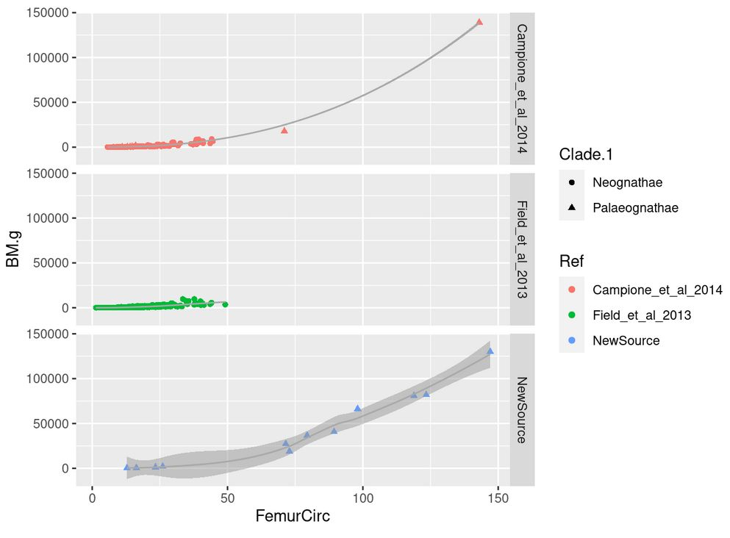
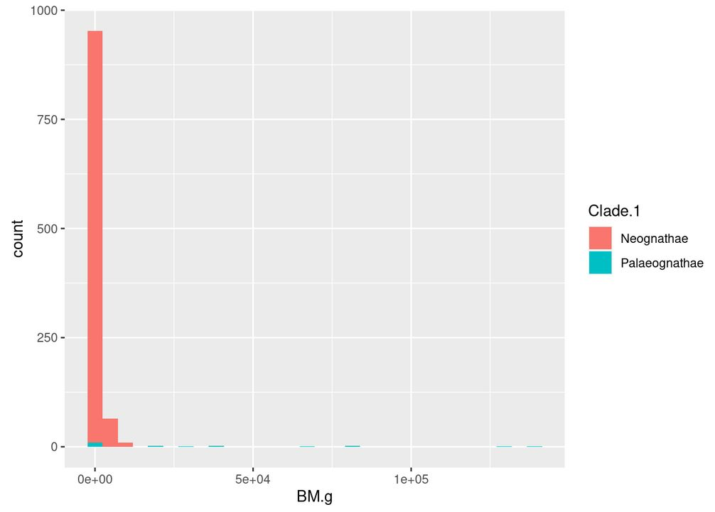
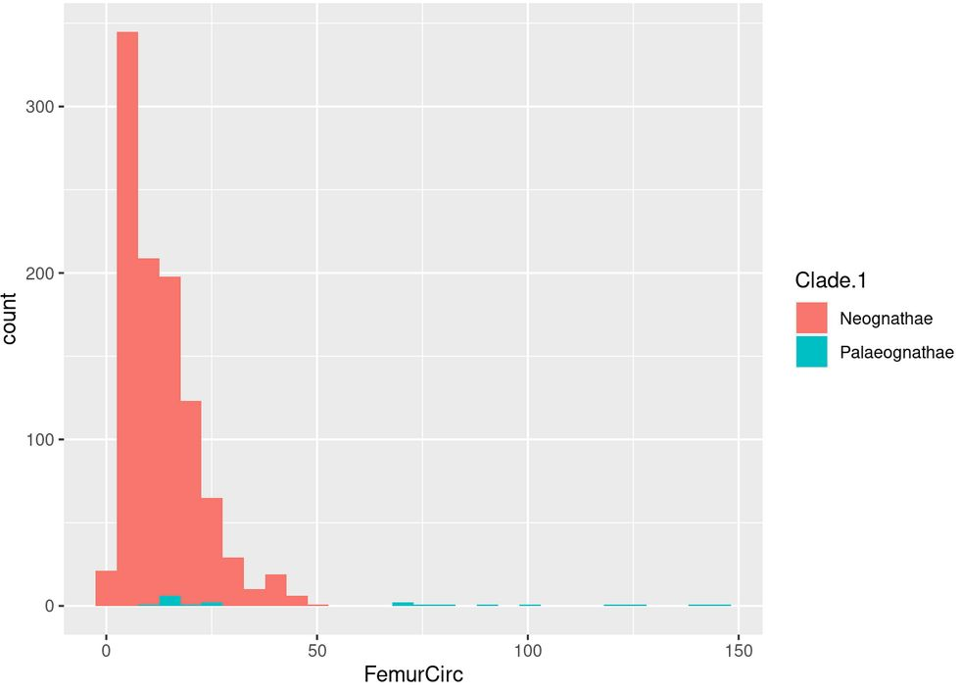
Body mass ~ Femur Circ

Slide 18
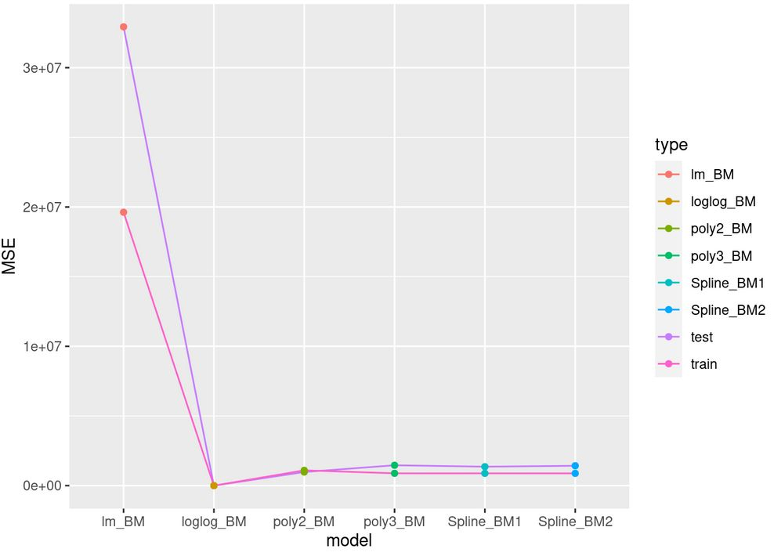
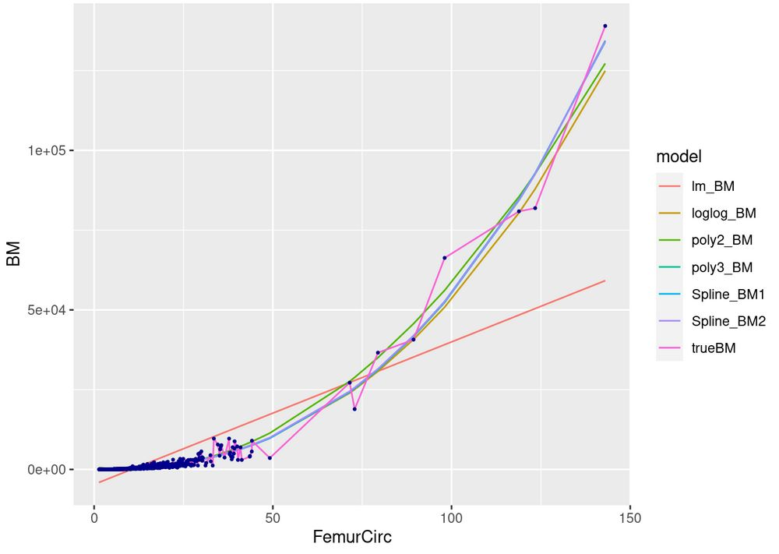
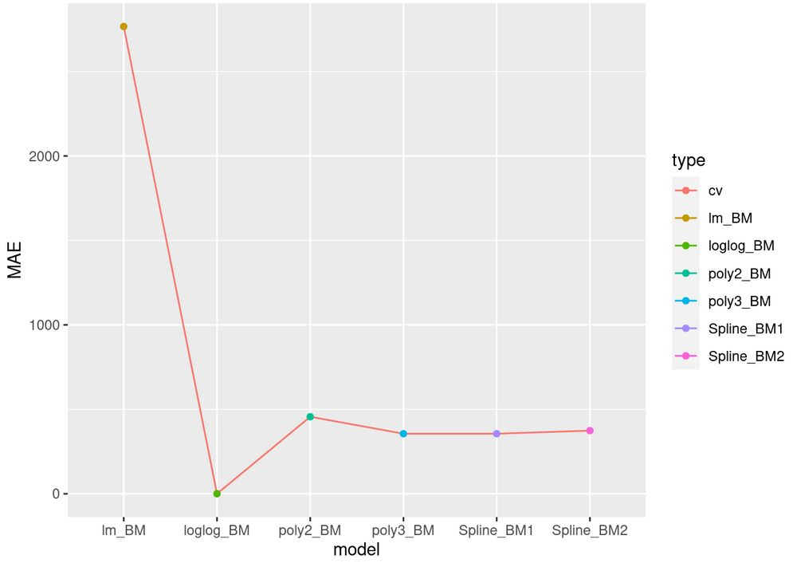
log(Body mass) ~ log(Femur Circ)
Adj R2
0.6062
0.9547
0.9813
0.9839
0.9845
0.9846

Slide 19
Body mass - paleoEstimation
Train: 80%
Test: 20%
Campione&Benson 2020
Chan 2017
Field et al 2013
Campione et al 2014
Distributions
BM.g ~ FC
log(BM.g) ~ log(FC)
BM.g ~ poly(FC, 2)
BM.g ~ poly(FC, 3)
BM.g ~ spline(FC, knot = 25)
BM.g ~ spline(FC, 25, 50)
MSE
Seed:999
Relationship
Best Model
Kfold (10) - Cross Valid.
MAE
Dataset
# sp: 446
# Orders: 27
# Obs: 1036
Femur Circumference ~ Femur Length
Prediction
Distributions
Relationship
Dataset
# sp: 552
# Orders: 32
# Obs: 1172
71 Observations
Theropods
Palaeognathae
Dataset
Distributions
Relationship
Dataset
# sp: 35
# Orders: 9
# Obs: 111
# sp: 15
# Orders: 5
# Obs: 20
FC ~ FL
FC ~ FL + Clade.1
FC ~ FL + Clade.2
log(FC) ~ log(FL)
log(FC) ~ log(FL) + Clade.1
log(FC) ~ log(FL) + Clade.2
FC ~ poly(FL,2)
FC ~ poly(FL,2) +Clade.1
FC ~ poly(FL,2) + Clade.2
Canoville et al 2022
Chadwick et al 2014
Crouch&Clarke 2019
Elzanowski&Louchart 2022
Gatesy&Middleton 1997
BM ~ 0.16 C_{femur} ^{2.73}
(Anderson et al 1985)
log10(BM) ~ 2.411 log₁₀ C_{femur} – 0.065
(Cambell Jr & Marcus 1992)
log(BM) ~ 2.4 log C_{femur} – 0.11
(Field et al 2013)
log(BM) ~ 2.754 log10 C_{femur} – 0.683
(Campione et al 2014)
log(BM) ~ 2.37699 log C_{femur} – 0.09121
(This analysis)
Back transform
$\sum{PPE}=\frac{\frac{\sum{Obs−pred}}{pred}∗100}{n}$
Train: 80%
Test: 20%
Whole dataset
Palaeognathae
Log
MSE
AIC
Prediction

Slide 20
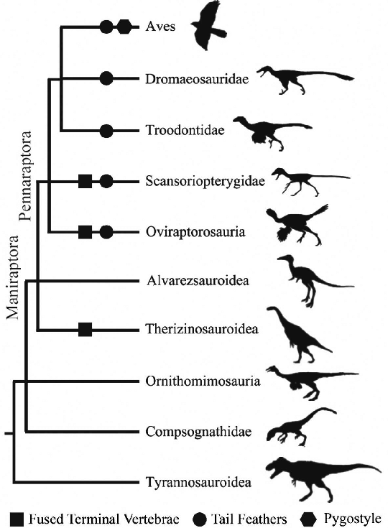
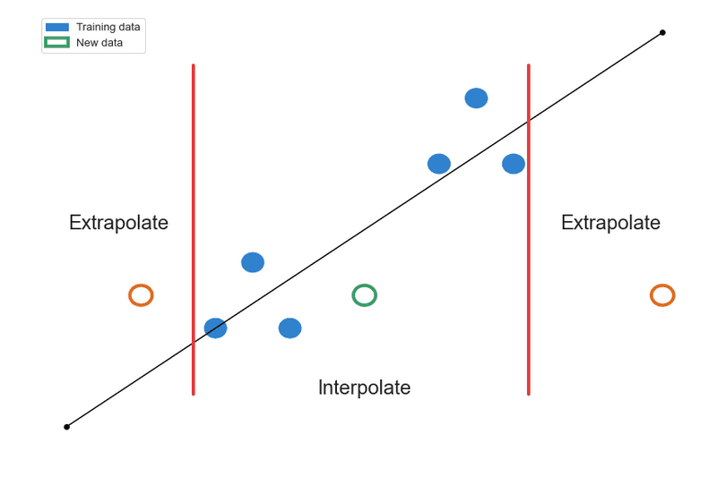
Aside Note
Theropods
Aves
Theropods

Slide 21
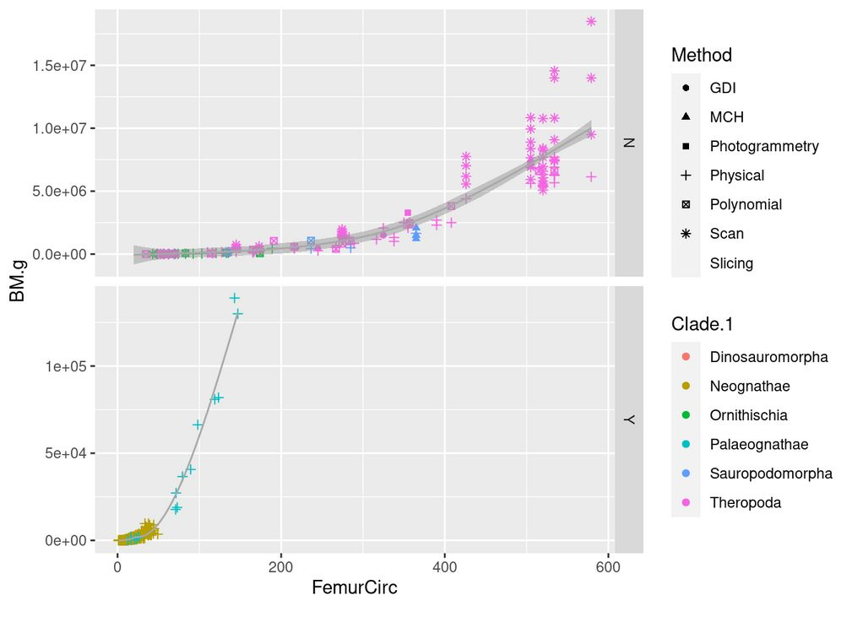
Predicting and comparing models
BM ~ 0.16 C_{femur} ^{2.73}
(Anderson et al 1985)
log10(BM) ~ 2.411 log₁₀ C_{femur} – 0.065
(Cambell Jr & Marcus 1992)
log(BM) ~ 2.4 log C_{femur} – 0.11
(Field et al 2013)
log(BM) ~ 2.754 log10 C_{femur} – 0.683
(Campione et al 2014)
log(BM) ~ 2.37699 log C_{femur} – 0.09121
(This analysis)

Slide 22
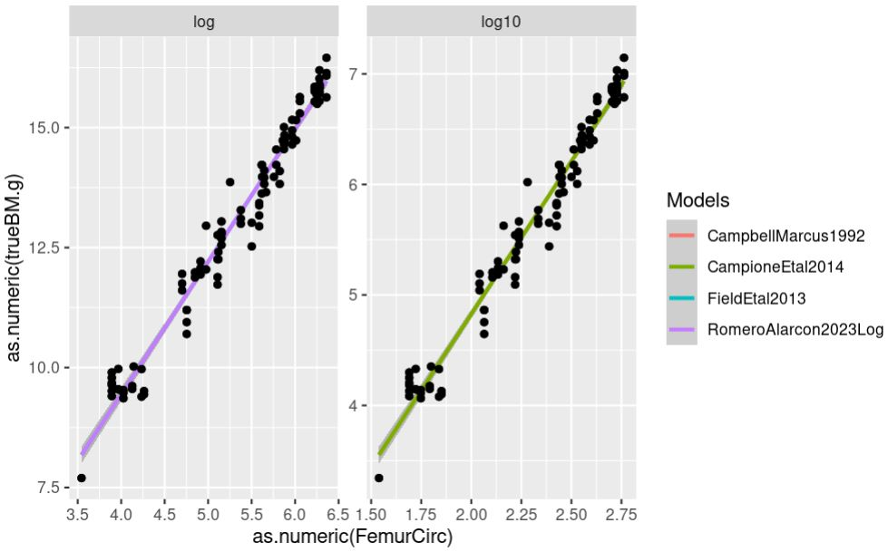
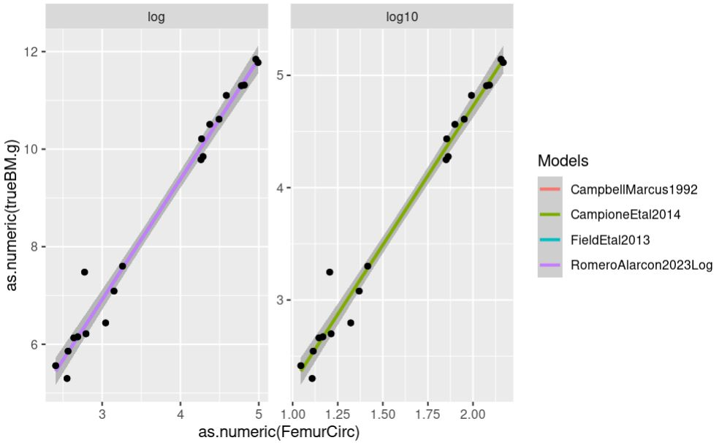
Log-Log Models
Theropods
Palaeognathae

Slide 23
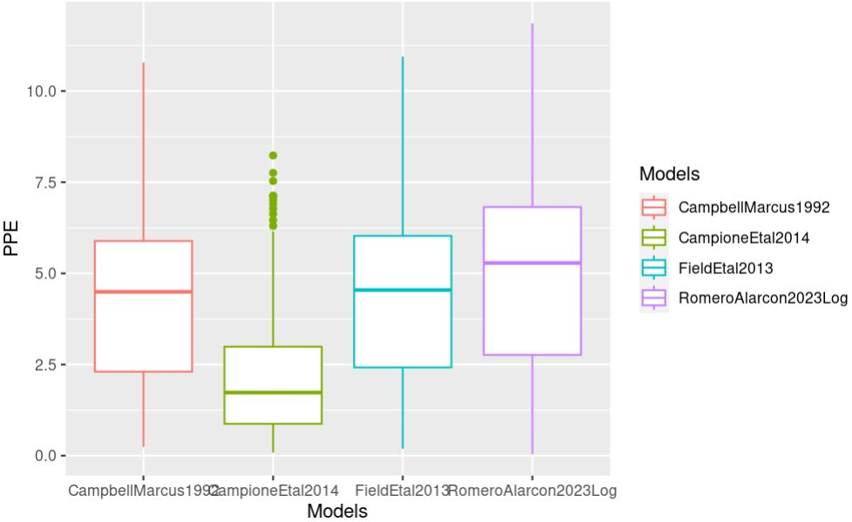
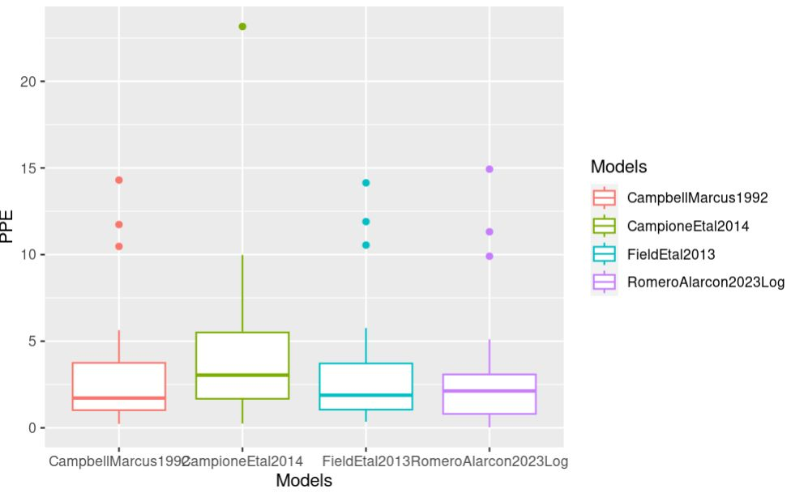
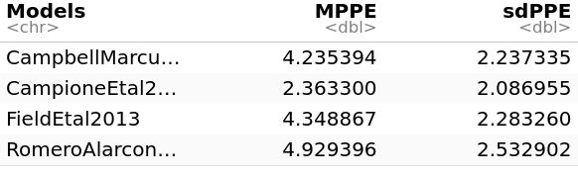
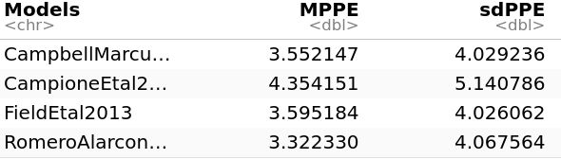
Log-Log Models
Theropods
Palaeognathae

Slide 24
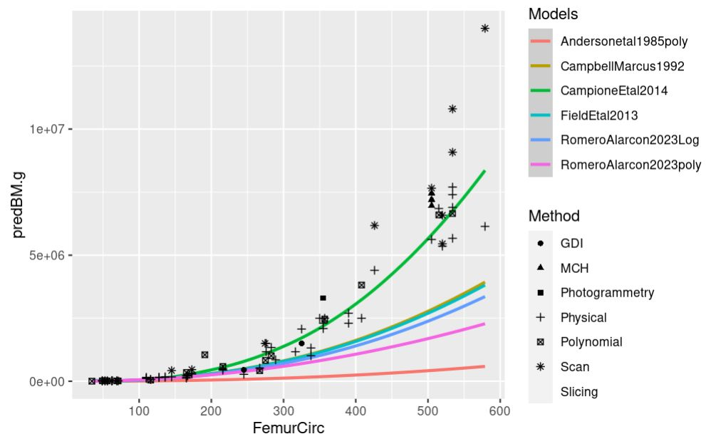
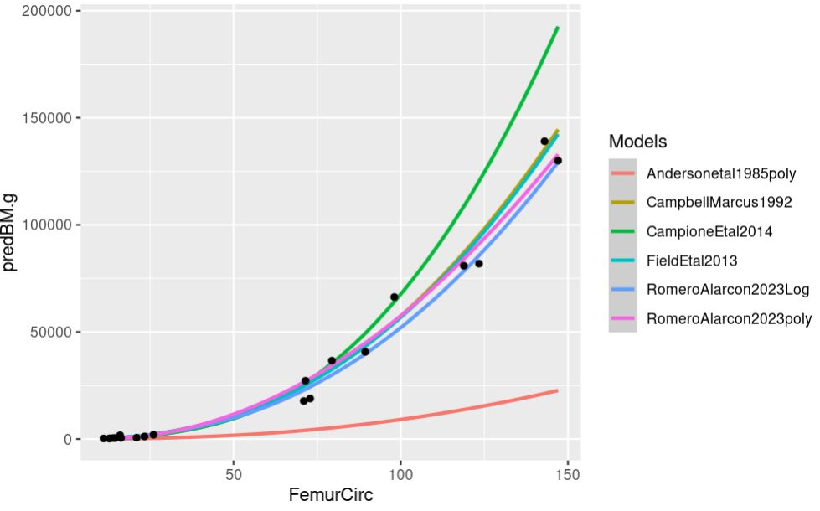
Back transform Models
Theropods
Palaeognathae

Slide 25
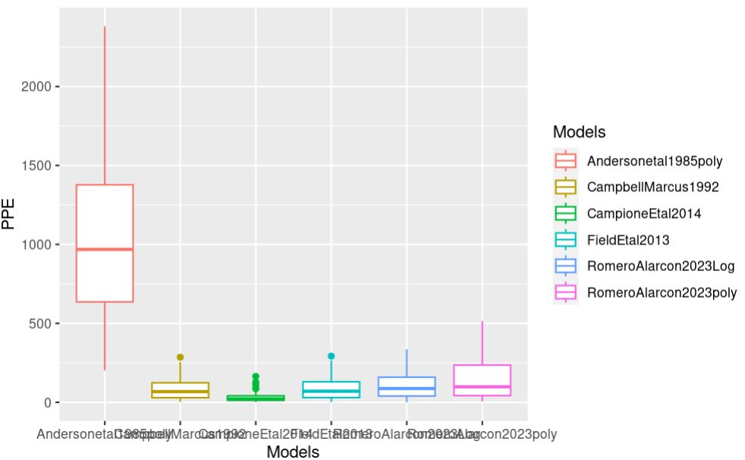
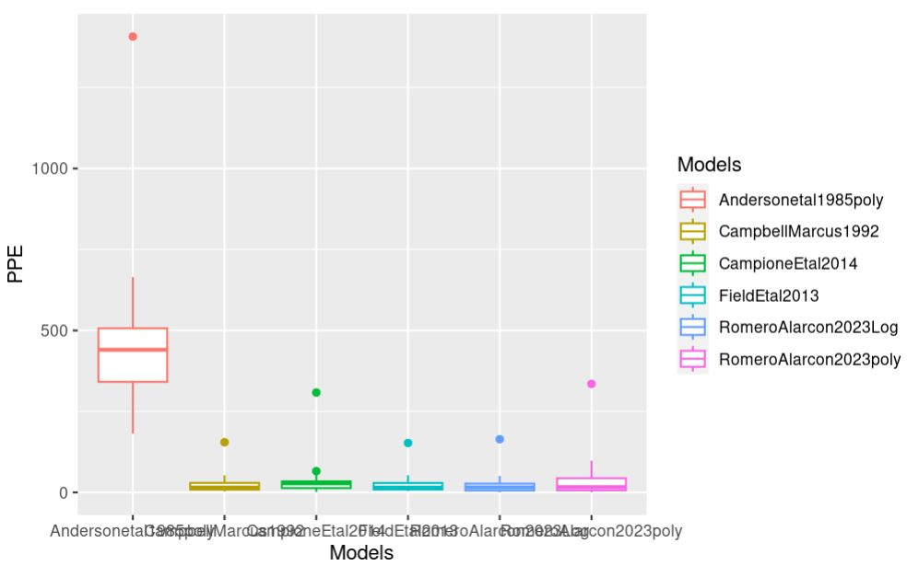
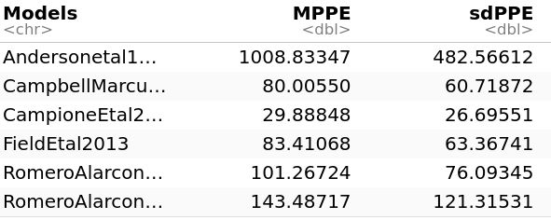
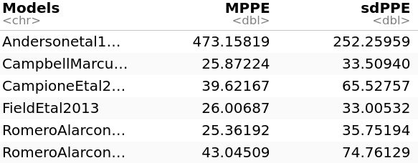
Back transform Models
Theropods
Palaeognathae

Slide 26
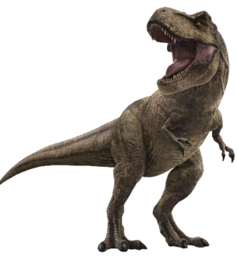
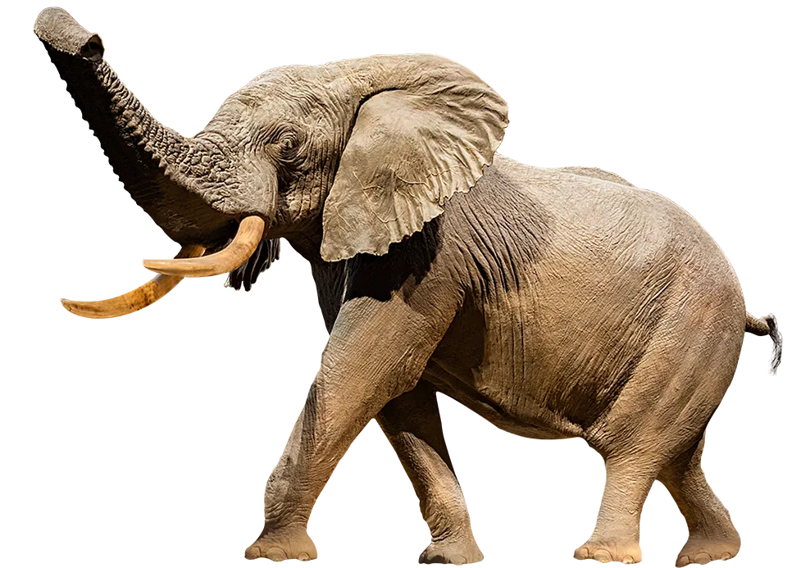
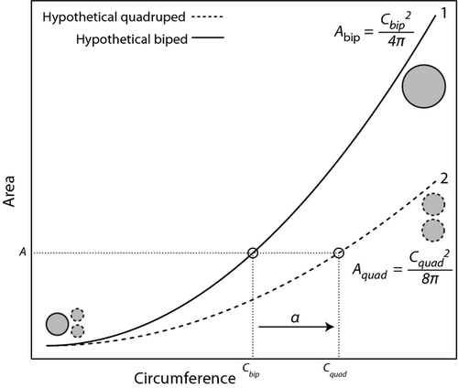
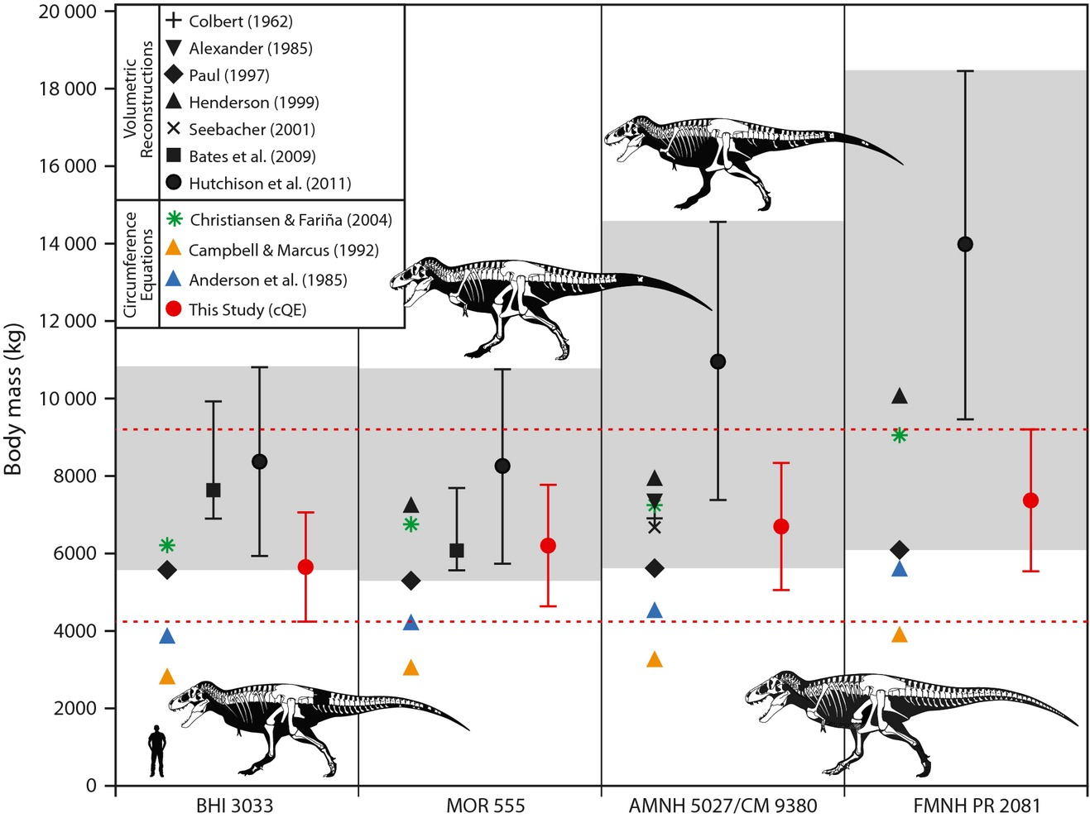
Why is Campione et al 2014 especial?
Campione et al 2014

Slide 27
Could I improve the model,
if I included samples from
the Palaeognathae group?
No, it is not possible
(Bright, 2021 in BBC)

Slide 28
What did we learn?
1) Campione et al 2014 model are better for extrapolating/predicting Body Mass in bipedal dinosaurs.
Or at least, it is the model that better predicts VD estimation.
2) The model fitted in this study is the best one for interpolating. It is relevant because most of BM estimations in
Terror birds has been estimated using Campione’s et al 2014 model..
3) Even though some authors support the idea that Femur Circumference is not affected/influenced by ancestry,
my analysis confirm that there is a effect at order level.

